Slide 1
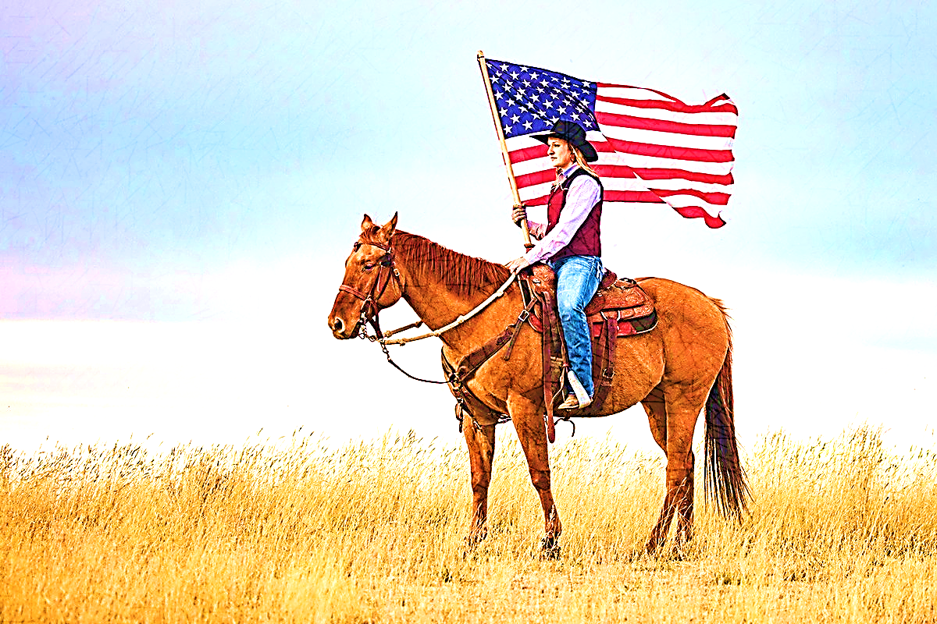
Cow Country Junior Rodeo
Manila, Utah
June 14 & 29
2023
July 7 & 8
2023
August 10 & 17
2023
September 4
2023
Entries close on June 1 and 15.
Late entries will be taken until June 10 and 25 and will include a $50 late fee.
Entries close on June 23.
Late entries will be taken until July 3 and will include a $50 late fee.
Entries close on July 27 and Aug 3.
Late entries will be taken until Aug. 6 and 10 and will include a $50 late fee.
Entries close on Aug. 21.
Late entries will be taken until Aug. 31 and will include a $50 fee.
Age groups are determined by contestant’s age as of January 1st, 2023
(Birth certificates may be requested if necessary)
*All contestants must compete in their own age division.
4 & Under - Goat Tail Ribbon Pull (No entry or fee required)
Pee-Wee: 5-9
Goat Tying, Pole Bending, Barrel Racing, Dummy Roping’, Saddle Bronc, Bareback, Mutton Bustin’ (5 & 6 yr. olds),
Steer Riding (7-9 yr. olds)
Junior: 10-13
Girls: Breakaway, Goat Tying, Pole Bending, Barrel Racing, Team Roping - Heading, Team Roping – Heeling
Boys: Goat Tying or Chute Tying, Breakaway, Chute Dogging, Team Roping – Heading, Team Roping – Heeling, Steer Riding, Saddle Bronc Steer Riding, Bareback Steer Riding
Senior: 14-17 (or the summer after their senior year of High School)
Girls: Breakaway Roping, Goat Tying, Barrel Racing, Pole Bending, Team Roping – Heading, Team Roping – Heeling
Boys: Tie-Down Calf Roping, Chute Dogging, Team Roping- Heading, Team Roping- Heeling, Bull Riding, Saddle Bronc Riding, Bareback Riding
Team Ropers may have an adult partner.
Points
All points accumulated this year will go toward the all-around in each age division.
Scholarship
Available for graduating seniors. Applications are on the website. The deadline is Sept. 1, 2023. Late applications will not be accepted.
Volunteering
Each family must volunteer once during each rodeo, to allow the rodeo to move smoothly and efficiently. A sign-up sheet will be available.
Health certifications & brand inspections are always required to cross state lines.
All entry fees are $15 per event $5 Arena fee per rodeo
Membership Fee for 2023 CCJR Series: $75/contestant –Due with 1st Entry
Payment Options: Venmo Payment or Online Entry through Website
*MEMBERSHIP forms and fees are required for each contestant. Fees must be paid prior to their first rodeo in order to compete.
*Please check the website http://www.ccjrrodeo.org
for rule updates, entry forms, and membership forms.
You may contact the CCJR Rodeo Committee by email at ccjrrodeo@gmail.com.

